Slide 1
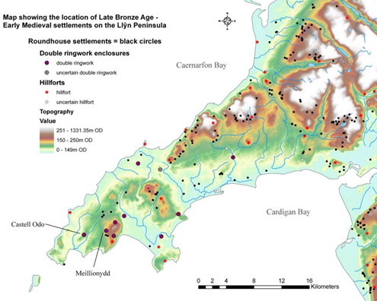
Meillionydd...
...and the beginning
of medieval Welsh society in c.6th cent. BC

Slide 2
Very simplified: early Mediaeval Welsh societies
complex chiefdoms / early ‘feudal’ states
  each a territorial (→ bro) and socio-political (→ tud) unit
    ruled by (petty) ‘king’ / ‘prince’ (→ brenin)
      travelling between several llysoedd (‚courts‘)
    with established, landowning ‘nobility’ / ‘gentry’
      (e.g. → breyr, note: from brogoriχ, ‚king of a country‘)
    with variable numbers of smallholders
    and with significant percentage of population being tenant farmers
      (→ taeog, note: from *tegesakos, ‘of the house(hold of another)’)
      working the estates of large landowners (i.e. of ‚king‘ and ‚nobles‘)
    effectively: a ‚household‘-based social organisation
  but also (still) strongly kinship-based (→ cenedl)
    as a socio-ideological fiction / justification of social order
      ‚king‘ construed as ‚father of nation‘; etc.
    but also in social reality
      e.g. of immense significance in law
        not just for inheritance, but also penal law, procedure, etc.
    and especially, determining internal ‚household‘ social structure
  at the brink of turning into monetary societies
    emerging market economy

Slide 3
Simplifying even further
essential features of EM Welsh societies
  exclusive individual ownership of (‚private‘) property
    especially land and other agricultural/pastoral resources
      held and controlled by separate, individual ‚households‘
  transferability of use (possession) of property rights
    ‚traded‘ in return for goods (‘rent’) and services (‘labour’)
    especially to/with tenants
      → become subordinate members of dominant ‚household‘
      → construed as ‚junior‘ kinsmen under ‚patria potestas‘ of landowner
  inheritability of such (at least ownership) rights
    primarily, but not necessarily exclusively, patrilineal
      reverting back to wider kin in case ‚household‘ dies out
  resulting in clearly established social stratification
    based on ‚trade‘ of property use rights (a ‚clientele‘ system)
    and ‚household‘-based inheritance of ownership rights
→ system for managing collaborative human labour

Slide 4
Pre-monetary economies and human labour
Managing collaborative human labour is a difficult problem in pre-monetary economies:
  one cannot easily ‚pay‘ for human labour
  → other means of motivating workforce necessary
Mobilising a workforce:
  no problem for ‚small‘ projects
    combined members of same subsistence economy unit
      e.g. family, household
    all share benefits of joint labour
      but: very limited resource – normally on average 2-10 people
      also: limited available time – need to produce subsistence goods
  big problem for ‚monumental‘ projects
      workforce greater than c. 10 people required
      for extended periods of time
    → how to motivate workers to collaborate in such projects?

Slide 5
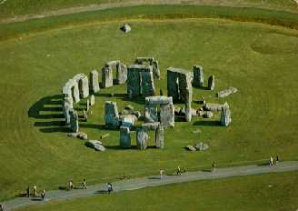
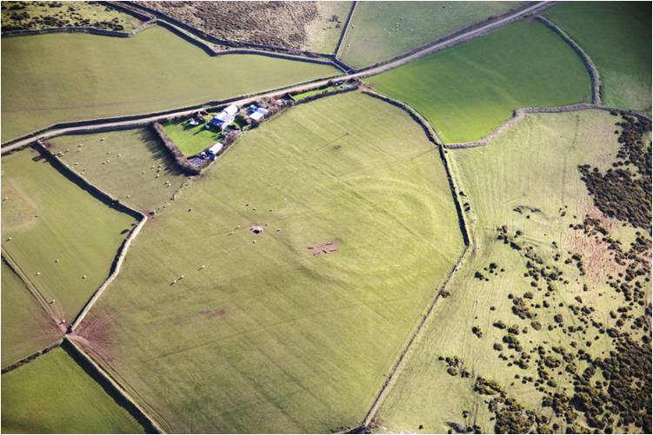
Monumentality
archaeologically traceable collaborative labour
  e.g.
  and distinguishable into
  monumentality
Stonehenge
Meillionydd
‚communal‘
and
‚private‘
‚exclusive‘
(for a small sub-set of a wider community)
‚inclusive‘
(for a wider community)

Slide 6
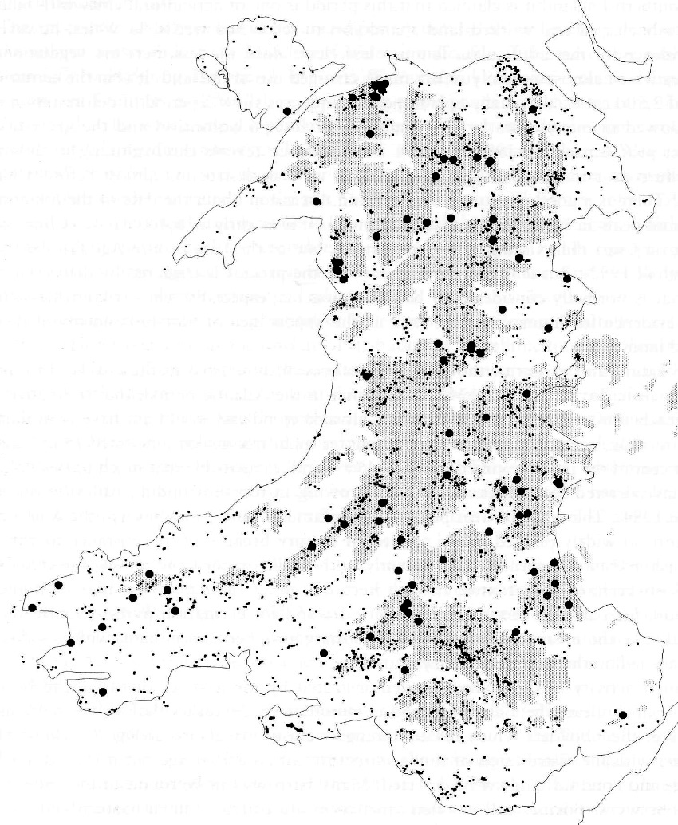
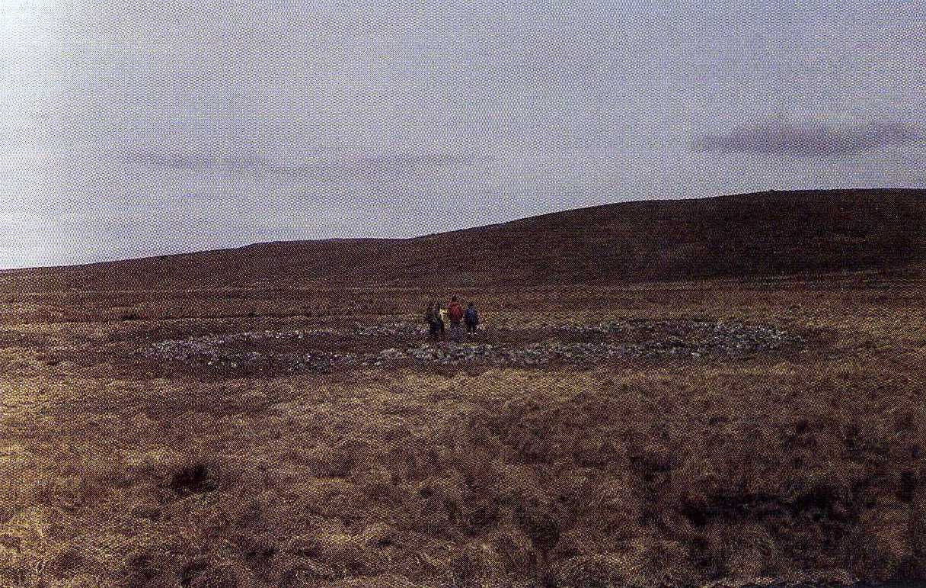
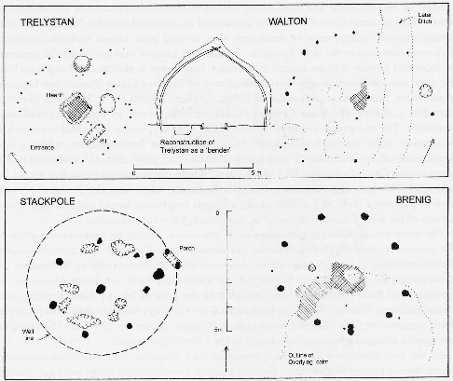
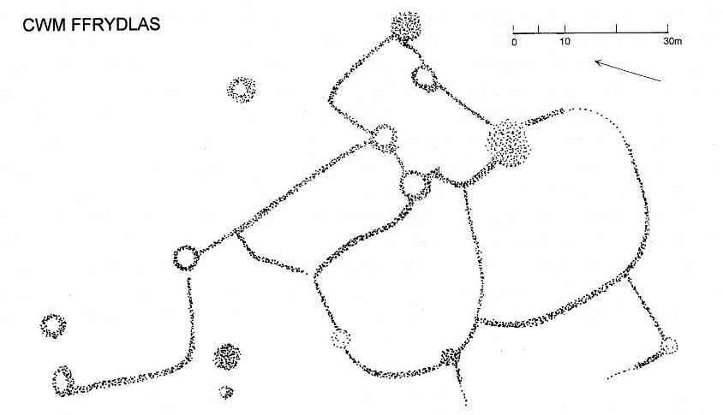
‚Communal‘ monumentality
characteristic for Welsh archaeological record
up until c. the middle / late Bronze Age
  e.g. stone and timber circles
  e.g. communal burial cairns
‚private‘ space is not monumentalised
  ‚egalitarian‘ settlement record
  individual and clustered roundhouses
  sometimes with small field systems
‚Monumentalising‘ use of manpower
  in communal ‚religious‘ contexts
  including ‚wider‘ communities
→ Religion: good motivator for ‚voluntary‘ labour investment into ‚monumental‘ projects
Burial cairns and timber circles in Wales (Lynch 2000, 82)
Welsh BA houses (Lynch 2000, 88)
Cwm Fryddlas BA houses and field systems (Lynch 2000, 88)
Cwm Cadlan ring cairn (Lynch 2000, plate 16)

Slide 7
‚Privatising‘ monumentality
First occurs around the start of 1st mill. BC
  mainly in the context of individual settlements
    but, significantly, not in all or even the majority thereof
→ wider community invests labour for the private benefit of a restricted subgroup (‘dominant lineage’)
  exclusive demarcation of (‚privately owned‘) property
  often long-lasting occupation, including re-design
    indication of inheritability of property
  often requiring ‚external‘ labour investment
    occupants likely insufficient to construct enclosure
    → indicating ‚tradeable‘ property rights in return for services
  indicating status distinction / social stratification
    (sometimes) even ‚internally‘

Slide 8
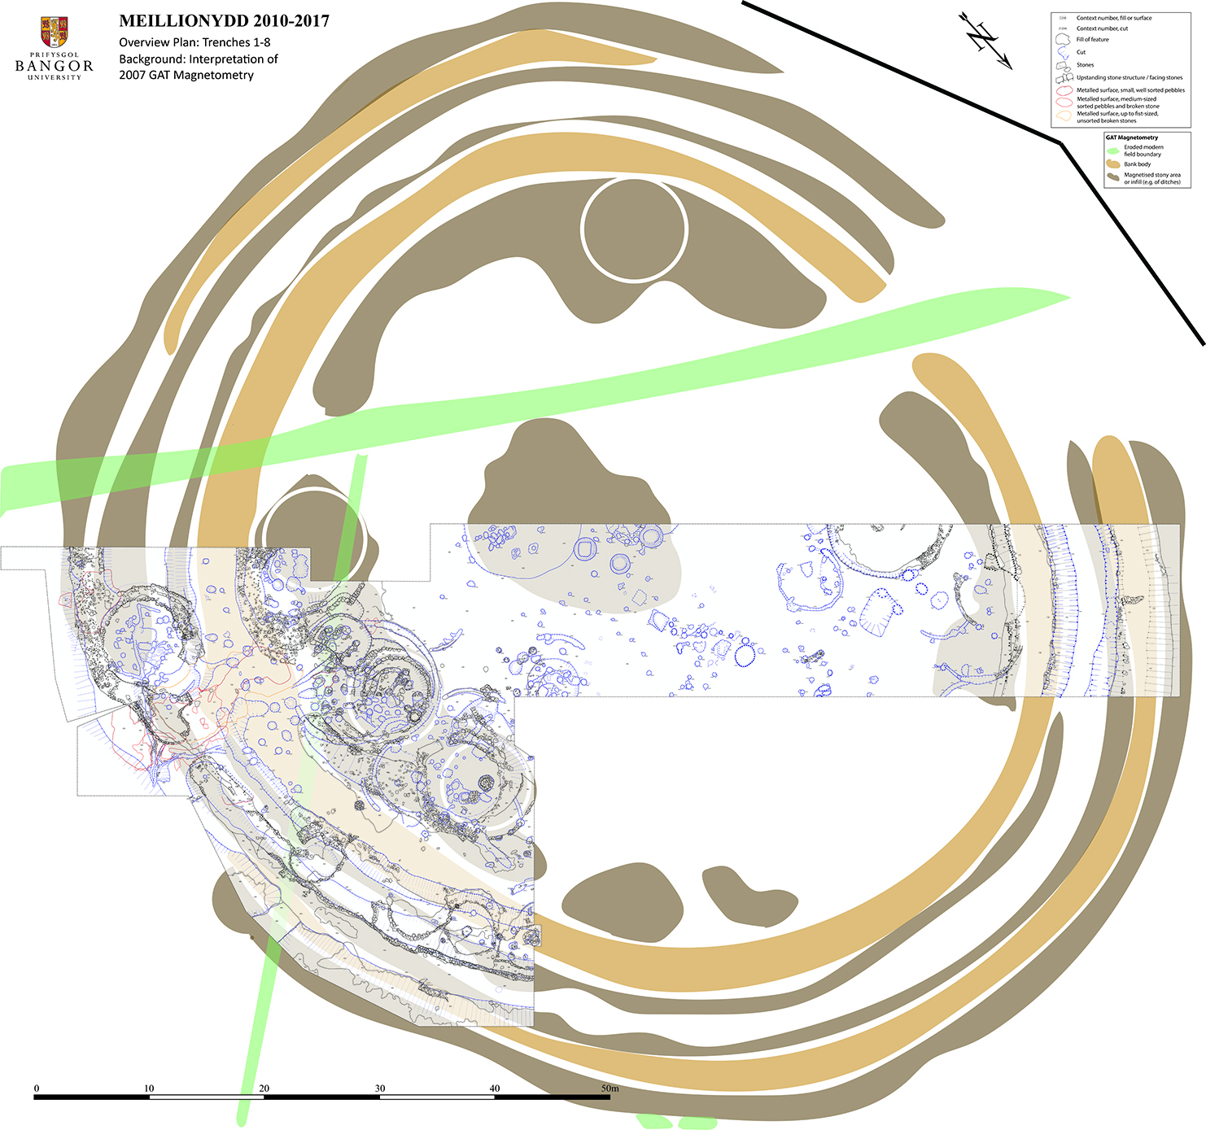
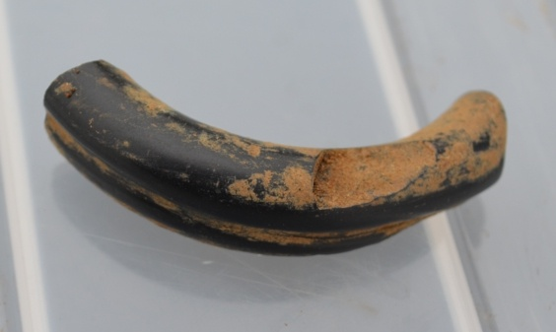
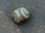
Meillionydd: a case study
Enclosed with double ditches and palisade c. 700 BC
Transformed into double ringwork enclosure c. 550 BC
Labour investment into banks c. 1,280 man-days = c. 40 men working for a month
Unlikely to have had more than 25 inhabitants
Occupied c. 8th-3rd cent. BC
Deposition of ‚prestige‘ goods in gate postholes
‚Internal‘ zoning of houses of different size and quality

Slide 9
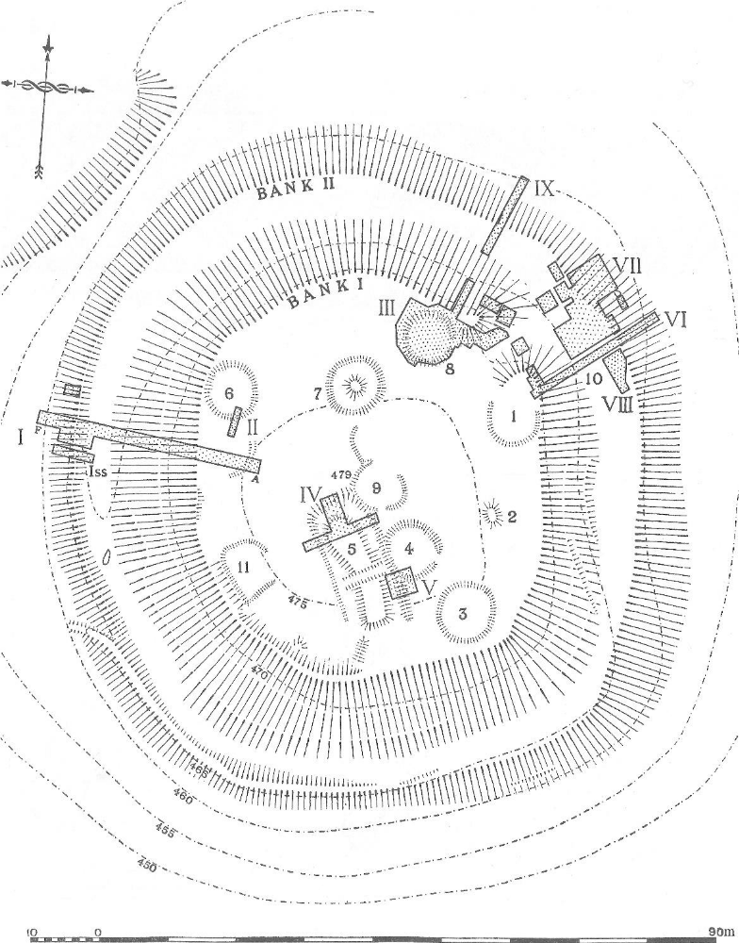
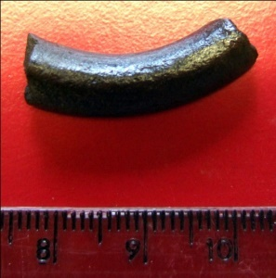
Castell Odo: a direct parallel
Just 3 miles from Meillionydd
Occupation starts in Late Bronze Age, probably 9th/8th cent. BC
Enclosed with timber palisade
c. 700 BC
Transformed into double ringwork enclosure c. 6th cent. BC
Labour investment into banks somewhat less than Meillionydd, c. 950 man-days = c. 30 men working for a month
Unlikely to have had more than 20 inhabitants
Similar finds spectrum to Meillionydd, e.g. jet bracelet fragment
Same late stage development as in Meillionydd, especially bank abandonment
(Alcock 1960)

Slide 10
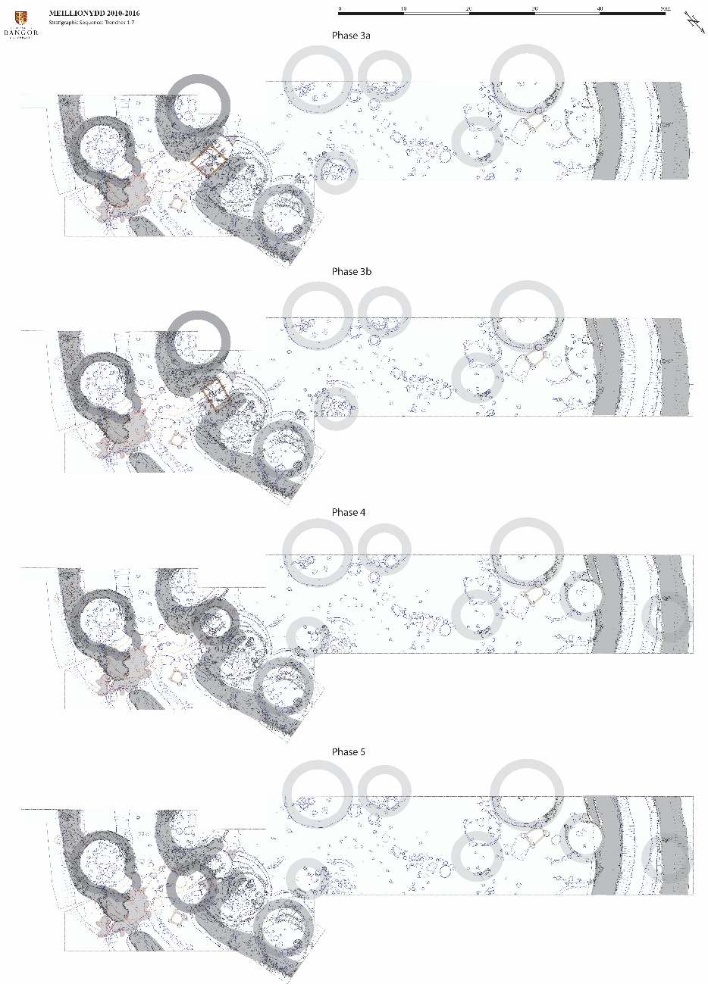
The Rise and Fall of the Lords of Meillionydd?
occupation sequence, c. 6th-4th cent. BC
Double ringwork phases (EIA):
Stone buildings
Double stone-faced dump rampart enclosure
Impressive inner gate passage with gatehouse
Later phases (EIA/MIA):
Stone buildings
Inner entrance blocked up
Eroding enclosure

Slide 11
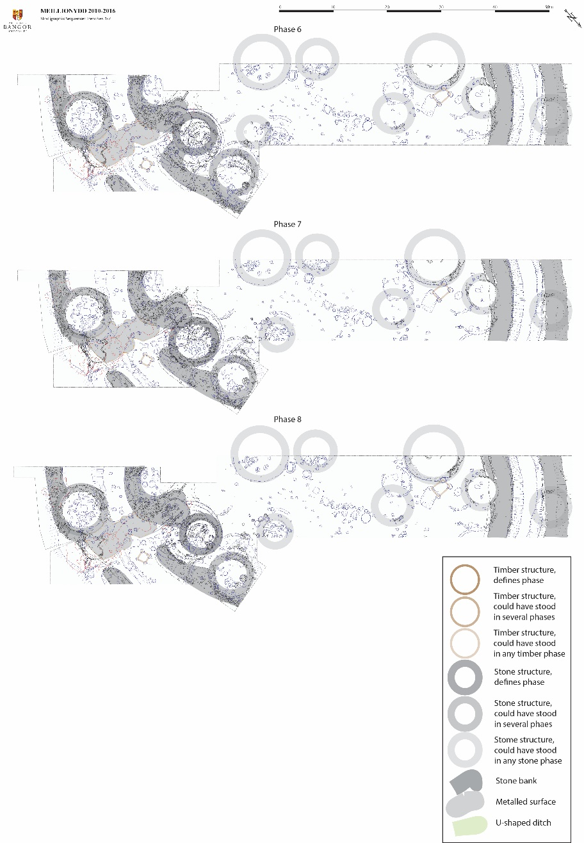
The Rise and Fall of the Lords of Meillionydd?
Late occupation sequence, c. 4th-3rd cent. BC
Standard interpretative narrative:
  settlement‘s (inhabitants) status increases
  until double embankment, then declines
Latest phases (MIA):
Stone buildings
Heavily eroded banks
Metalled road running over inner bank terminal
Several phases of RH construction completely obliterating former inner entrance passage

Slide 12
‚Faked‘ status vs. ancient pedigree
constructing enclosures is a labour-intensive task
  but: not massively so, e.g. at Meillionydd
    2 banks at c. 45 and 55 m radius = c. 640 m length
    volume at c. 4 m width and 2.5 m height = c. 6.400 m³
    assuming c. 5 m³ per man per day of shovelling
    = c. 1.280 man days
    → 10 men working c. 3-4 months
‚faking‘ status would be relatively easy
  any social upstart who can organise a few buddies can build a double ringwork like Meillionydd
    demonstrates (some) control over a surplus of manpower
    but doesn‘t demonstrate long-term stability of that control
reliable long-term stability crucial for tenants:
  why make oneself dependent on unreliable ‚lord‘?
  especially if other, more reliable ‚lords‘ are available?
→ ‚ancient pedigree‘ of ‚lordly‘ reliability essential!

Slide 13
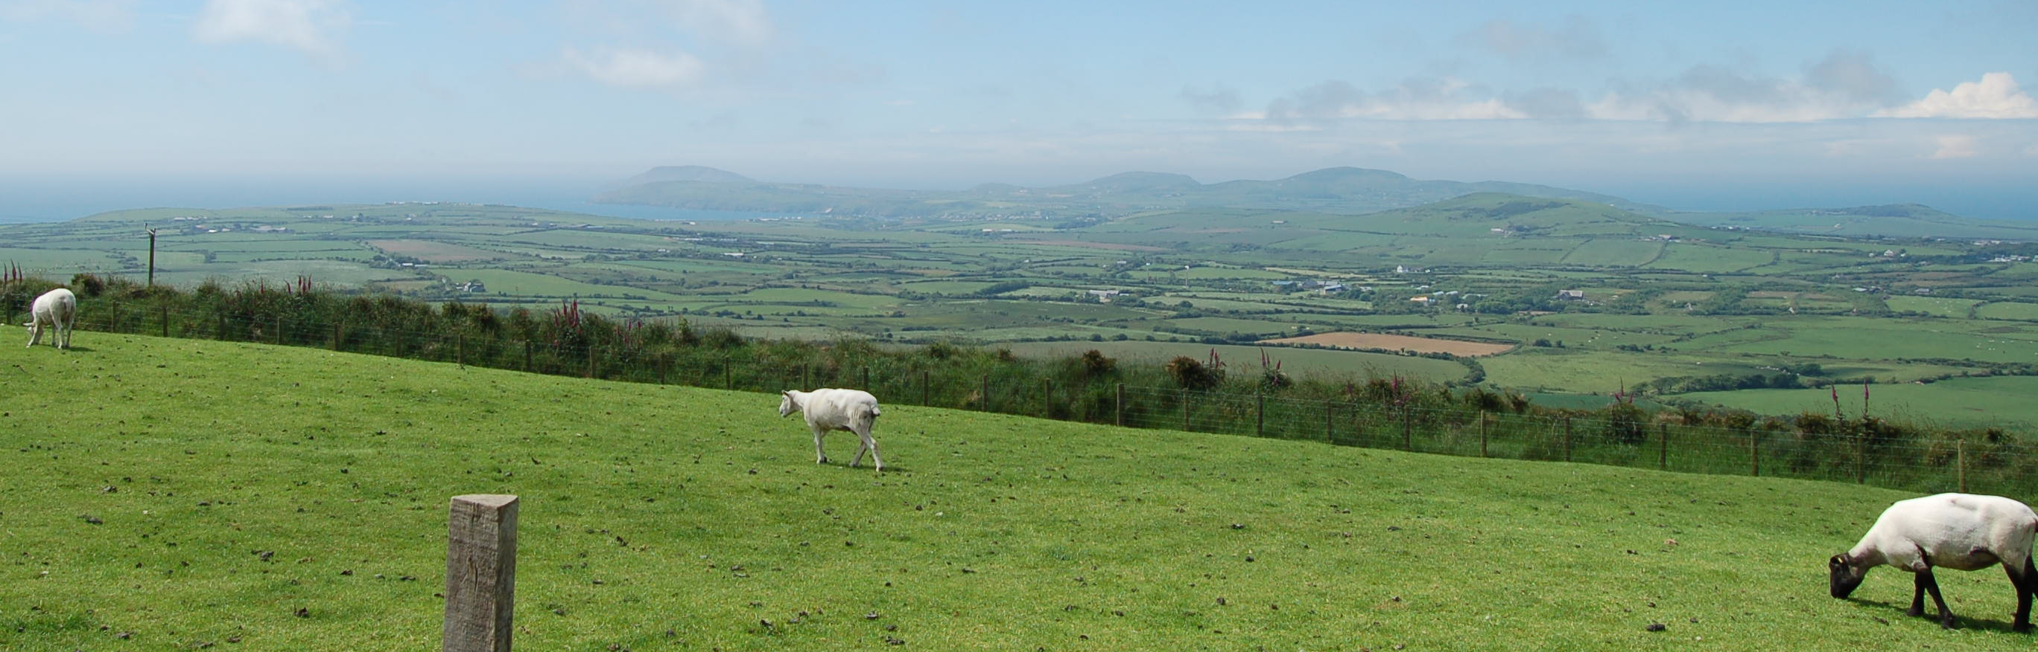
Demonstrating ancient pedigree
is where eroding banks come in:
  virtually everyone can build ‚new‘ banks
  ‚faking‘ old banks is much more difficult
    not just because of memory of long-term existence
A partially decayed and slowly eroding fieldwall (built in the same technique as the LBA/IA banks) next to the site at Meillionydd. They have a very characteristic appearance during an extended period of slow erosion and decay with steep sides and partly collapsed areas with considerably amounts of stone tumble.

Slide 14
Sequences like at Meillionydd & Castell Odo
  demonstrate the emergence of societal features
    transformation of (hereditary) possession into ownership / separation of concepts of possession and ownership
      allowing for use (possession) of property to become transferable
      in return for good (‚rents‘) and services (‚labour‘)
    inheritability of ownership rights
      within individual lineages of wider kin-groups / ‚households‘
      enabling emergence of ‚large estates‘ (law of increasing returns)
    emergence of a ‚stable‘ (established) social stratification
      based on ‚pedigree‘ and ‚clientage‘
      ‚stackable‘: tenant borrows property from landowner, who borrows property from large estate owner, etc.
  increases efficiency of ‚private‘ management of labour
    allowing (dominant) ‚households‘ to harness larger workforces
    in pre-monetary economies
  → enabling the ‚privatisation‘ of monumentality

Slide 15
Gradual local emergence of features
These core features seem to emerge locally
  no ‚external‘ influence discernible
    virtually all ‚monumentalised‘ features develop out of indigenous (architectural) traditions
    in NW Wales, if at all, there is ‚Irish‘ influence
      part of the ‚Irish Sea‘ aceramic zone in Iron Age
      enclosures like Meillionydd as similar to EM Irish ‚ringforts‘
      as to IA and RB British ‚enclosed homesteads‘
  and gradually, between MBA and EIA
    house-associated field boundaries from middle BA
      → emergence of (inheritable?) ‚private‘ possession of real estate
      roughly contemporary with loss of ‚communal‘ monumentality
    ‚privatised‘ monumentality mainly around 1000-500 BC
      → emergence of (inheritable) ‘private’ ownership of real estate
      → emergence of possession transfer-based status distinctions

Slide 16
The sudden emergence of a new social order
during LBA/EIA in Britain
  inheritable ownership of real estate develops
  within a mainly kin-based social organisation
leads to rapid process of societal transformation
  on the Llŷn, within c. 100-200 years around c. 600 BC
    apparently simultaneously at several sites
  new social system rapidly accepted and embedded
    need for AM disappears on Llŷn within a few generations
becomes long-term stable system
  dominates Western Europe for next c. 2 millennia
  in Wales (and Ireland etc.), this creates the kinds of societies later attested in medieval sources

Slide 17
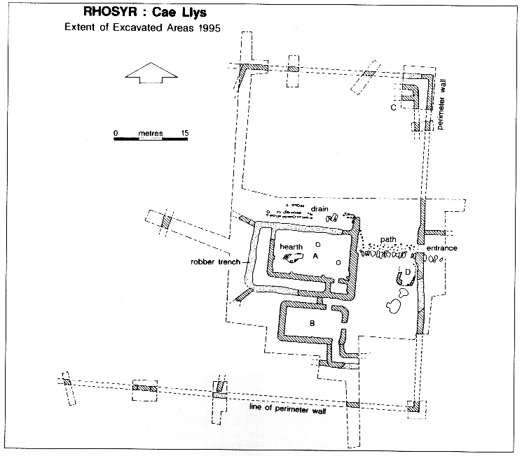
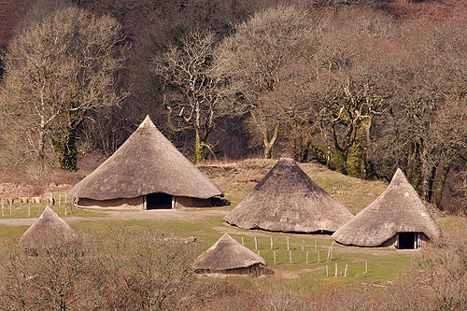
Thank you for your attention!
Cymr. llys = ‚court‘
(an enclosed space, particularly an enclosed settlement; of a nobleman, a church, or of law; especially the lowland residences of itinerary medieval Welsh princely courts – as opposed to their castles, which control access to the uplands)
Cymr. henllys = ‚old court‘
(remains of an embanked enclosure, often of LBA/IA/RB date; frequently found on large landed estates, often close to its medieval or early modern main residential building)
Llys Rhosyr,
11-13th cent. AD court
of the Princes of Gwynedd
Castell Henllys, IA enclosure

