Slide 1

Lay Judges in the European Union – Developments
Stefan Machura, Bangor University
s.machura@bangor.ac.uk

Slide 2
Definition
Lay judges do not „live“ of judging.
Lay judges do not have to have a formal legal training.
(In another take, lay judges are temporary judges – with legal qualification)

Slide 3
Of the people, sitting as single judge or in panels
Lay judges are “of the people”, representing
  The citizenry in general
  Specific social groups
  Special professional experience/expertise.
Lay judges sit in panels, or as single judge, including in mixed tribunals with professional judges.

Slide 4
Principle forms of courts
Table 1: Principal forms of courts
 | Single decision maker | Group of decision makers
Lay judges only | Single lay judge | Panel of lay judges
Combination of lay and professional judges |  | Jury (professional judge presiding) Mixed court
Professional judges only | Single professional judge | Panel of professional judges
Machura 2016, 241

Slide 5
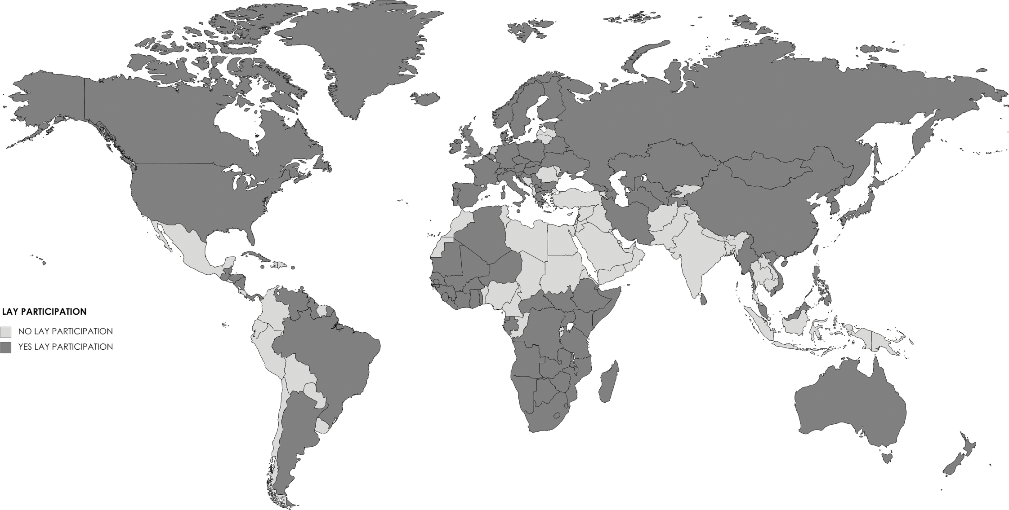
Almost all European countries employ lay judges in criminal courts
Source: Kutnjak Ivkovich and Hans 2021
Source: https://static.cambridge.org/binary/version/id/urn:cambridge.org:id:binary-alt:20210729134844-82877-mediumThumb-48394fig16_1.jpg?pub-status=live

Slide 6
Similar for civil justice
No lay participation in civil justice | Single lay judge / mediator in civil justice | Panel of lay judges in civil justice | Professional judge, lay jury in civil justice | Mixed tribunal in civil justice
Croatia Estonia Greece Latvia Lithuania Netherlands Slovak Re-public | Belgium France Germany Portugal (Spain) | France | Ireland | Austria Belgium Bulgaria Croatia Cyprus Czech Republic Denmark Finland France Germany Hungary Italy Luxembourg Malta Poland Romania Slovenia Sweden
Situation as of 2011 updated,
Machura 2016, 247

Slide 7
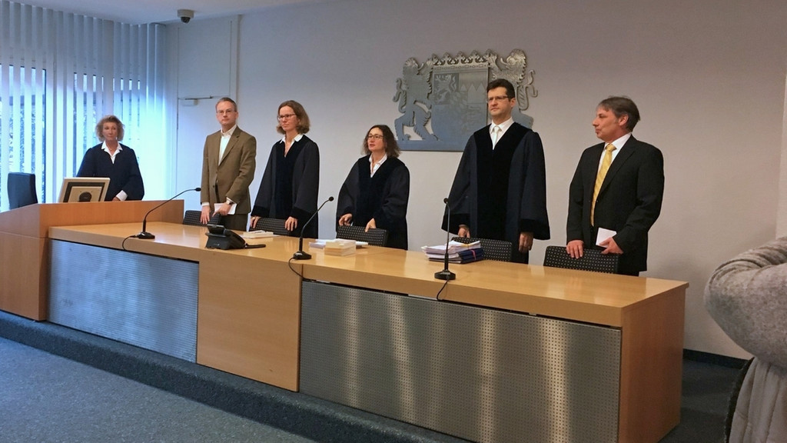
Other courts with lay participation in Europe
Administrative courts (e.g. Austria, Germany)
Military (disciplinary) tribunals (e.g. Germany)
Verwaltungsgericht München, from left to right: (law clerk) lay judge, professional side judge, presiding professional judge, professional side judge, lay judge.
https://www.br.de/nachrichten/bayern/dieselfahrverbot-muenchen-verwaltungsgericht-ruegt-freistaat,Qi6yV12 (Accessed 1 May 2023).

Slide 8

Up and down result of:
Democratisation of state and society – UP
Economic crises and emergency situations (as pretext) – DOWN
Re-design of court system - SIDEWAYS
Specific critique of court decisions – UP/DOWN

Slide 9
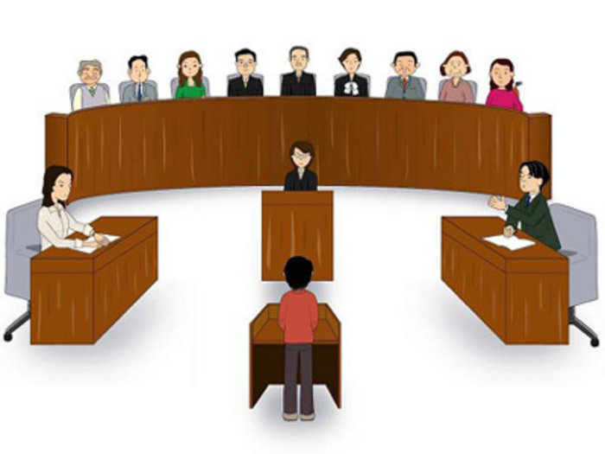
Lay participation as move to democratise/modernise
Japan introduced a mixed court in 2009
Picture: https://apjjf.org/-David-T.-Johnson/3212/article.html (accessed 1 May 2023).

Slide 10
Curtailing lay participation in times of crisis
Poland as a recent example where the government tries to minimise lay participation (Cain 2016).
  Lay participation has been „systematically limited“ since the 1990ies and now stands at less than 0.6% of criminal proceedings (Małolepszy and Głuchowski, 2018, 89, 100).
A lay judge wrote that the Covid crises was taken as a pretext for further cuts, many of which are still in effect after the general application of safety measures was lifted in other areas of life (Kwiatkowski 2023).

Slide 11
Re-design of the justice system
French juges de proximité became part of a category of temporary judges, which also includes legally trained parttime judges.
  The special court for neighbourhood disputes is dissolved and instead the task of providing justice “close to citizens” is distributed more widely across courts and their actors.
  (Zwickel 2017, on the “magistrate exercising on a temporary basis”: Ministère de la Justice n.d.)

Slide 12
Changes following criticism of court decisions
In Scotland (no longer in the EU), the conviction rate for all crime is about 88%, but only 43% for rape and attempted rape.
Rape Crises, a campaign group, called for the abolition of jury trials in rape cases as jurors would believe in “rape myths”.
Scottish Government draft bill to introduce a sexual offenses court for rape cases
  Run a pilot to conduct trials without juries.
There is resistance from defense lawyers.
(BBC 2023)

Slide 13
Different again in France
About half of the cases are taken from the jury: the rape cases.
A special rape court is being created: 5 professional judges.
Here, feminist organisations oppose the change, as they see sexual crimes against women as a social problem and the jury has a role in educating citizens.
A trial was held and appeals from the jury court are lower than from the new court.
(Fiorini 2023)

Slide 14
Summary
The lay judge is a citizen of Europe.
Although not existentially threatened, lay participation waxes and wanes.

Slide 15
References
BBC (2023). Not Proven Verdict to be Scrapped in Scottish courts, 27 April 2023, https://www.bbc.co.uk/news/uk-scotland-65397235 (Accessed 1 May 2023).
Cain, Bettina (2016). Quo vadis polnische Justiz? Richter ohne Robe 29(2), 70-72.
Fiorini, Benjamin (2023). Benjamin Fiorini: „“C’est le moment de se mobiliser contre la disparition des jurys populaires!“ (Interviewed by Sophie Tardy-Joubert, https://www.actu-juridique.fr/droit-penal/benjamin-fiorini-cest-le-moment-de-se-mobiliser-contre-la-disparition-des-jurys-populaires/ (Accessed 2 May 2023).
Kutnjak Ivković, Sanja, and Valerie P. Hans (2021). A Worldwide Perspective on Lay Participation. In Sanja Kutnjak Ivkovich et al. (eds.), Juries, Lay Judges, and Mixed Courts: A Global Perspective, Cambridge: Cambridge University Press, pp. 323 – 345.
Kwiatkowski, Jan (2023). Letter to ENALJ conference, e-mail 29 March 2023 (on file with author).
Machura, Stefan (2016). Civil Justice: Lay Judges in the EU Countries. Oñati Socio-Legal Series, 6(2), 235-254 [online].
Małolepszy, Maziej, and Michal Głuchowski, (2018). Participation of Lay Judges in Criminal Proceedings in Poland and Germany. Ius novum 12(2), 86-1006 (online).
Ministère de la Justice (n.d.). Magistrat exerçant à titre temporaire, http://www.metiers.justice.gouv.fr/magistrat-12581/magistrat-exercant-a-titre-temporaire-12884/#:~:text=Statut%20du%20magistrat%20exer%C3%A7ant%20%C3%A0%20titre%20temporaire&text=Le%20MTT%2C%20nomm%C3%A9%20par%20d%C3%A9cret,l'%C3%A2ge%20de%2075%20ans. (Accessed 30 April 2023).
Zwickel, Martin (2017). Das Ende der französischen jurisdictions und juges de proximité, Richter ohne Robe 29(2), 58-61.

