Slide 1

Reliability of an Isometric Dynamometer to Assess Neck Strength in Female University Rugby
Darcey Atkinson, Eloise Kirby and Dr Julian Owen

Slide 2
Background
28% increase in female participation in rugby union since 2017 (1)
Neck strength associated with concussions (2)
Higher isometric neck extension = lower rates of concussion (3)
Females 47% lower isometric neck strength (4)
Difference in player position (5)(6)(7)
Notes:
Rugby union is gaining popularity in the female population with a 28% increase in registered female players since 2017. However, only few studies have assessed
Research suggests that there is a link between neck strength and concussion rate, with higher isometric neck strength equating to a lower rate of concussion.
Females have a 47% lower isometric neck strength than males potentially putting them at an increased risk of concussions.
Previous research has also suggested that there is a difference in neck strength between forwards and backs in male rugby. There is also research that found sigifinciant difference in neck extension strength in female university rugby players.

Slide 3
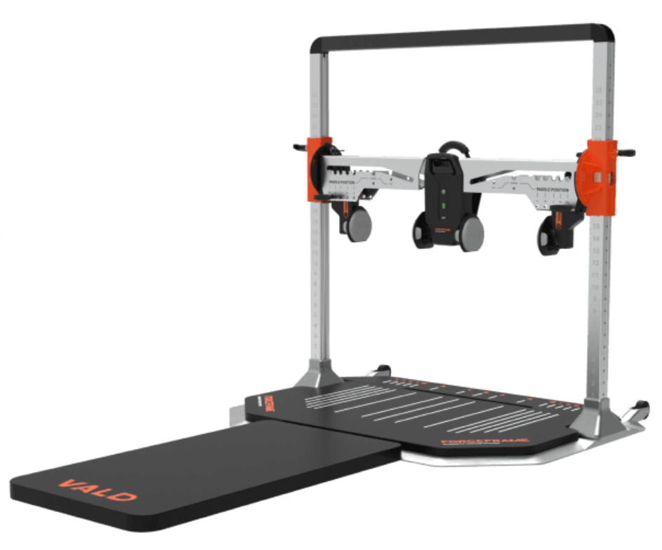
Measuring Neck Strength
Hand-held dynamometer (HHD) (2)(3)
Fixed-frame dynamometer (FFD) (8)
VALD ForceFrame (9)
Image available from: https://valdperformance.com/products/forceframe
Notes:
The use of isometric testing in rugby players is well documented in the literature. Isometric testing is used to measure maximum strength across a joint and this is usually done with a piece of equipment called a dynamometer.
There are 2 main ways of measuring neck strength. Firstly with a hand-held dynamometer which is a portable, easy to use device. However, reliability of HHDs can be affected by strength of the tester and stabilisation of the device.
Secondly is a fixed-frame dynamometer. There are different types of FFD including the Mulit cervical rehabilitation unit and the VALD Forceframe. These show good reliability – higher than that of HHD as the device is fixed and not affected by strength of the tester.
The VALD ForceFrame is a specific type of FFD which has been demonstrated to show good rto excellent reliability in previous studies assessing isometric strength.

Slide 4
Aims
To determine if the VALD ForceFrame is a reliable method of testing neck strength
To generate normative neck strength data

Slide 5
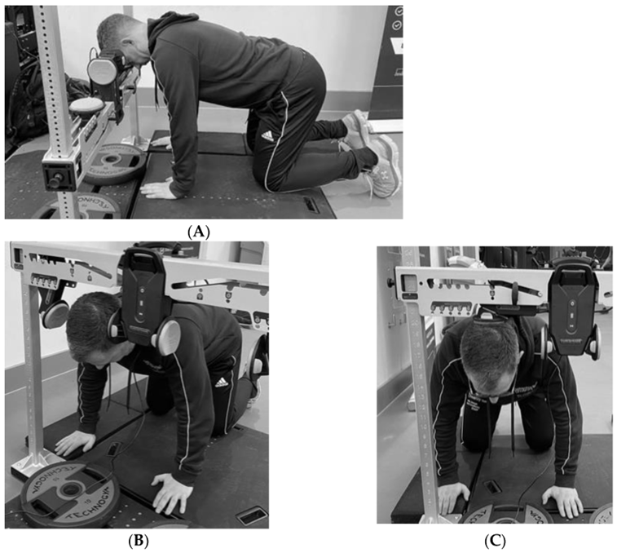
Method
n=8 Bangor University Women’s Rugby Union players
Neck strength measured using VALD ForceFrame
Maximum voluntary isometric contraction (MVIC) in each direction
Intraclass correlation coefficients (ICCs) with 95% confidence intervals (CIs) calculated
Image available from: https://www.mdpi.com/2075-4663/11/1/2
Notes:
A convenience sample of 8 Bangor university womens rugby union players was used. This study used a double-session repeated measures design with participants attending on 2 separate occasions for testing.
Neck strength was measured using the VALD ForceFrame, testing neck strength in 4 directions: flexion, extension, LSF, RSF. The pictures on the left side of the slide demonstrate how the VALD ForceFrame is used – particpiants asked to assume the quadruped position and push against the load cell as hard as they can for 3 seconds followed by a 10 second rest, this was repeated 3 times and the MVIC in each test direction was recorded.
ICCs with 95% CIs were calculated for each test direction

Slide 6
Results
Mean MVIC:
Extension 168.58 ± 34.93N
Flexion 143.58 ± 29.61N
LSF 103.33 ± 20.65N
RSF 103.06 ± 24.74N
No significant difference between forwards and backs
ICCs and 95% CIs:
Extension 0.77 (0.29, 0.95)
Flexion 0.86 (0.46, 0.97)
LSF 0.54 (-0.29, 0.89)
RSF 0.66 (0.08, 0.92)

Slide 7
Why is this important?
Neck strength data similar to previous research (7)(10)
Significantly higher neck extension strength
No significant difference in neck strength between forwards and backs
Reliability of ForceFrame moderate to good
Notes:
The results demonstrated that our neck strength values were similar to those found in previous studies assessing neck strength in female university rugby players, lending validity to our results.
Our results demonstrated that neck extension strength was significantly higher than any other test direction, which is supported by previous literature. Reasons for the higher neck extension strength include that upper limb strength training as well as actually playing rugby can have the additional benefit of strengthening the neck extensors.
We also found no significant difference between neck strength between forwards and backs.

Slide 8
References
World Rugby. (2024). Women's Rugby. https://www.world.rugby/organisation/about-us/womens
Collins, C. L., Fletcher, E. N., Fields, S. K., Kluchurosky, L., Rohrkemper, M. K., Comstock, R. D., & Cantu, R. C. (2014). Neck Strength: A Protective Factor Reducing Risk for Concussion in High School Sports. The Journal of Primary Prevention, 35(5), 309-319. https://doi.org/10.1007/s10935-014-0355-2
Farley, T., Barry, E., Sylvester, R., Medici, A. D., & Wilson, M. G. (2022). Poor isometric neck extension strength as a risk factor for concussion in male professional Rugby Union players. British Journal of Sports Medicine, 56(11), 616-621. https://doi.org/10.1136/bjsports-2021-104414
Williams, E. M. P., Petrie, F. J., Pennington, T. N., Powell, D. R. L., Arora, H., Mackintosh, K. A., & Greybe, D. G. (2022). Sex differences in neck strength and head impact kinematics in university rugby union players. European Journal of Sport Science, 22(11), 1649-1658. https://doi.org/https://doi.org/10.1080/17461391.2021.1973573
Geary, K., Green, B. S., & Delahunt, E. (2013). Intrarater Reliability of Neck Strength Measurement of Rugby Union Players Using a Handheld Dynamometer. Journal of Manipulative and Physiological Therapeutics, 36(7), 444-449. https://doi.org/https://doi.org/10.1016/j.jmpt.2013.05.026
Salmon, D. M., Sullivan, S. J., Handcock, P., Rehrer, N. J., & Niven, B. (2018). Neck strength and self-reported neck dysfunction: what is the impact of a season of Rugby Union? The Journal of sports medicine and physical fitness, 58(7-8), 1078-1089. https://doi.org/10.23736/s0022-4707.17.07070-0
Williams, E. M. P., Petrie, F. J., Pennington, T. N., Powell, D. R. L., Arora, H., Mackintosh, K. A., & Greybe, D. G. (2022). Sex differences in neck strength and head impact kinematics in university rugby union players. European Journal of Sport Science, 22(11), 1649-1658. https://doi.org/https://doi.org/10.1080/17461391.2021.1973573
Chiu, T. T. W., & Lo, S. K. (2002). Evaluation of cervical range of motion and isometric neck muscle strength: reliability and validity. Clinical Rehabilitation, 16(8), 851-858. https://doi.org/10.1191/0269215502cr550oa
McBride, L., James, R. S., Alsop, S., & Oxford, S. W. (2023). Intra and Inter-Rater Reliability of a Novel Isometric Test of Neck Strength. Sports, 11(1), 2. https://www.mdpi.com/2075-4663/11/1/2
Petrie, F. J., Williams, E. M. P., Mackintosh, K. A., Starbuck, C., & McNarry, M. A. (2024). Assessing the feasibility of a neck-strength training intervention in university women's rugby. European Journal of Sport Science, 24(4), 466-473. https://doi.org/https://doi.org/10.1002/ejsc.12028

Slide 9



Thank you for listening!
Questions?
This study is part of a wider research project at Bangor University examining injury risk in girls’ community rugby, the Welsh Injury Surveillance in Girls’ Youth Rugby - Funded by World Rugby and supported by the Welsh Rugby Union
For more details scan the QR code
or visit https://www.bangor.ac.uk/wisgyr

