Slide 1
“It’s the economy, stupid”
IOD North Wales Spring Leaders Lunch (15 March 2024)
Dr Edward Thomas Jones¹
¹Bangor Business School. E-mail: e.t.jones@bangor.ac.uk. LinkedIn: in/edwardthomasjones
Notes:
Good afternoon. Thank you for the invite to be here with you today.
I’m Dr Edward Thomas Jones, Senior Lecturer in Economics here at Bangor Business School, I’m Director of the Institute of European Finance (IEF) research centre, a Non-Executive Director at our science park on Anglesey (M-SParc), and also Chairman of Y Gymdeithas, an £22m Anglesey-based grant-making charity.

Slide 2
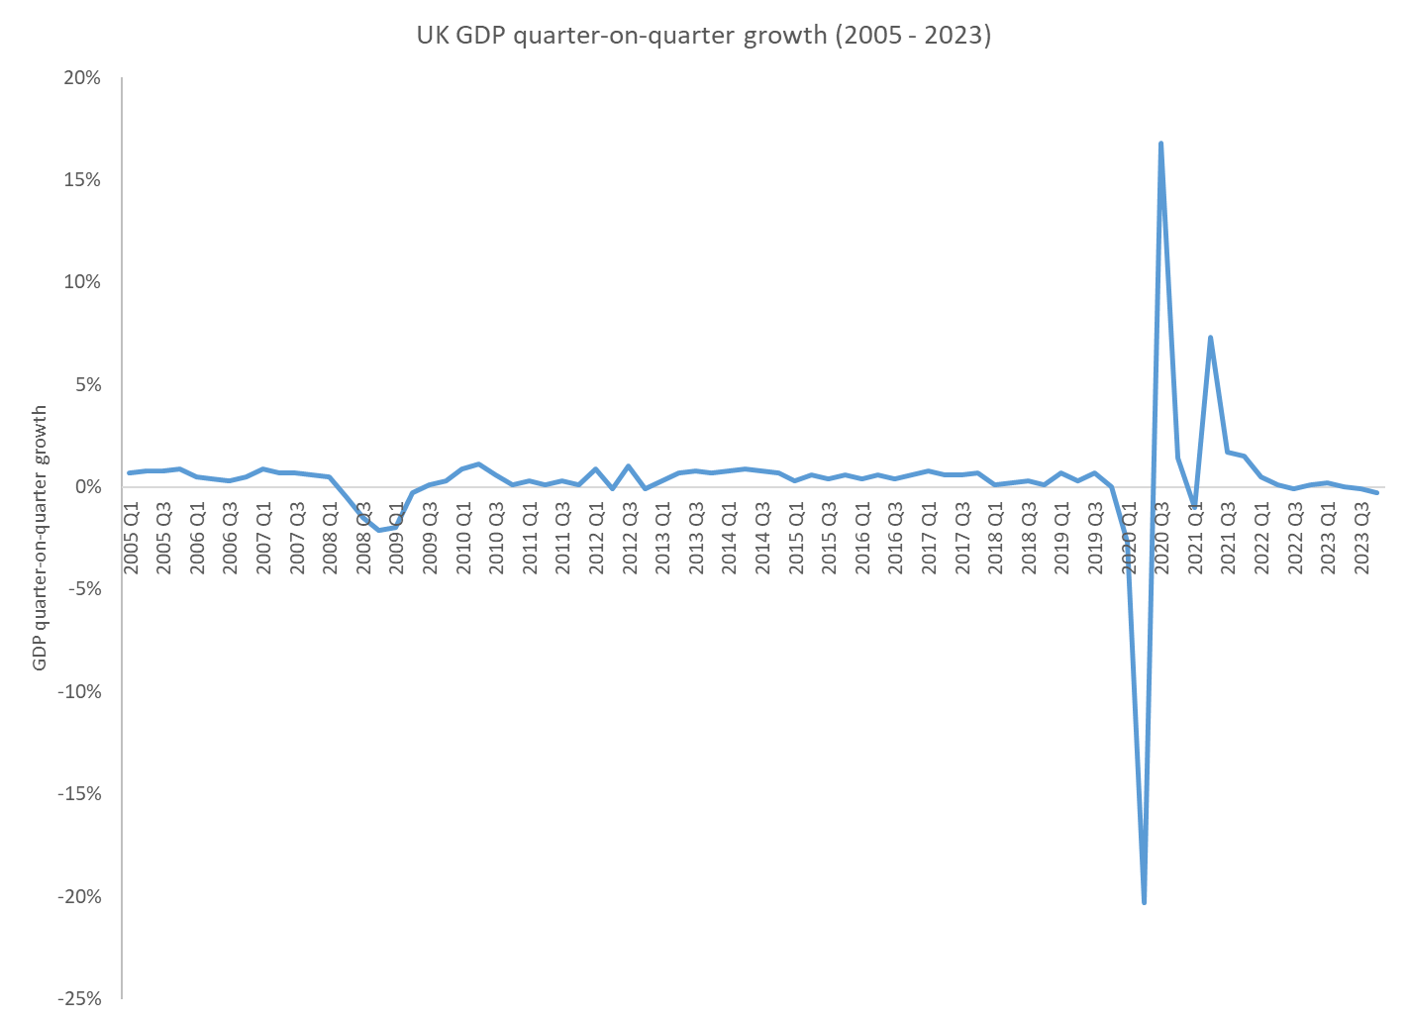
Twf CMC
GDP growth
Austerity
Covid-19
Financial crisis
Brexit
High inflation
Ffynhonnell / Source: www.ons.gov.uk/economy/grossdomesticproductgdp
Notes:
It’s fair to say that the UK and the Welsh economy has been through a lot in recent years. We had the 2007/08 financial crisis, austerity, uncertainty surrounding Brexit, Covid-19, and recent high levels of inflation. These events had a much bigger impact than just economic. In a global context, it is likely that the pandemic contributed to the context in which anger and despair boiled over into outrage and unrest following the death of George Floyd outside a shop in Minneapolis, Minnesota. Other possible coronavirus-induced impacts range from a full-blown financial crisis to a step change in the rate of the global energy transition.
It was announced during this week that the UK economy returned to growth in January helped by the expansion of the services sector, following a technical recession in the second half of 2023. Gross domestic product rose 0.2 per cent between December last year and January. Despite the monthly growth in January, the economy remained fragile. Output was down 0.3 per cent compared with January 2023 reflecting the impact of high interest rates and the cost of living crisis.

Slide 3
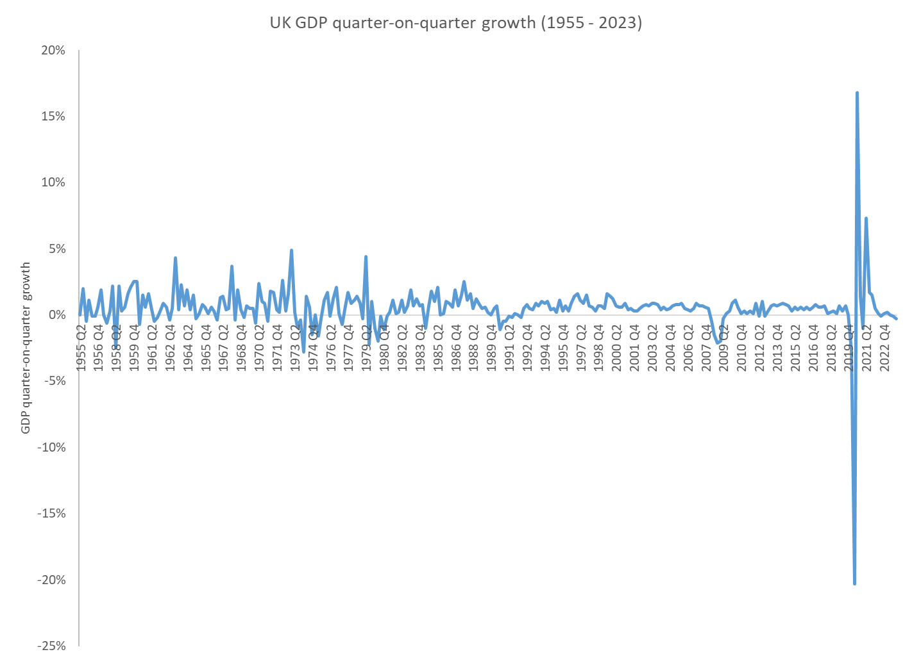
Twf CMC
GDP growth
Ffynhonnell / Source: www.ons.gov.uk/economy/grossdomesticproductgdp
Notes:
But capitalism is having/ had a mid-life crisis. Questions about capitalism's trajectory of endless growth with profit as the sole metric have moved from shouting on the streets to conversations in the boardroom. Concerns about plastic use have developed into a major climate crisis movement, which is now among voters’ top priority in many countries. Covid-19 has accelerated this trend.
People are putting organizations and companies under pressure to define their successes in more life-enhancing ways than financial growth. As companies start to re-evaluate their role in the world, their transformation will have to switch focus from profit to purpose.

Slide 4
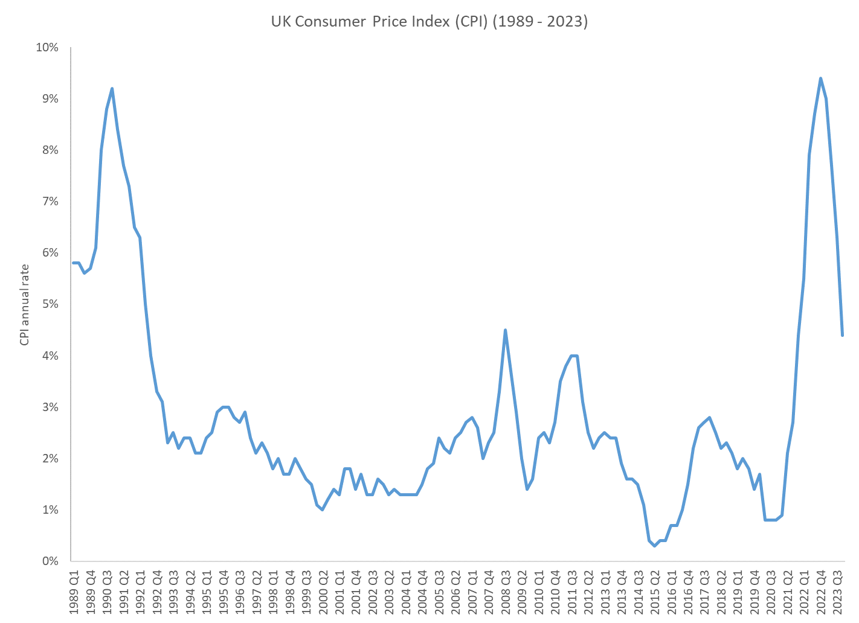
Chwyddiant
Inflation
Ffynhonnell / Source: www.ons.gov.uk/economy/inflationandpriceindices
Notes:
Data from the ONS showed that twelve-month Consumer Price Index (CPI) inflation in the UK was 4.0% in January 2024, the same level as December 2023, but continuing the decreasing general trend since the recent high of 11.1% in October 2022. The largest downward contributions to the slowing of the CPI rate into January 2024 were coming from food and household goods. Services inflation, which policymakers view as a better measure of domestic price pressures, was also lower than expected, edging up from 6.4 per cent to 6.5 per cent. Core inflation — which excludes energy, food, alcohol and tobacco — remained steady at 5.1 per cent.
In February, the Bank of England maintained the Bank Rate at 5.25% despite progress in curbing price rises. With headline inflation now 4 per cent compared with its 2022 peak of more than 11 per cent, the bank has ditched its previous warnings that “further tightening” of monetary policy might be needed. Instead, the BoE said it would “keep under review” how long rates should be held at current levels. The meeting marked a pivot more than two years after the central bank embarked on an aggressive rate-raising campaign that took borrowing costs to their highest level in 15 years.

Slide 5
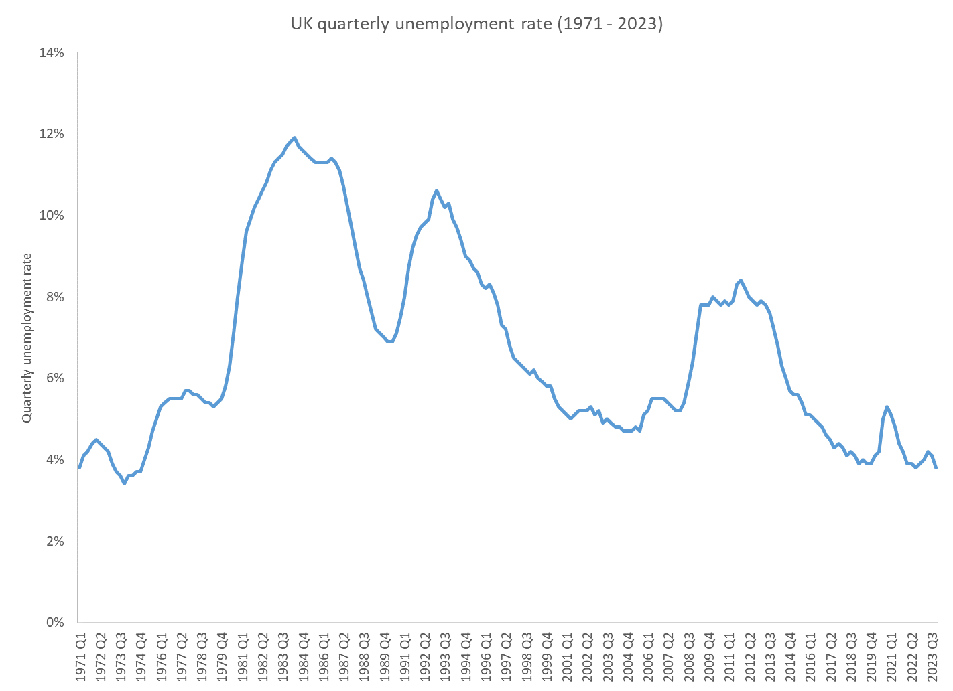
Diweithdra
Unemployment
Ffynhonnell / Source: www.ons.gov.uk/employmentandlabourmarket/peoplenotinwork/unemployment
Notes:
The Bank of England will lack crucial insights on unemployment as it makes key decisions on interest rate cuts in the coming months after the Office for National Statistics admitted last month that publication of unemployment and employment figures based on its “transformed” labour force survey should be treated with caution, as continuing problems with the survey underpinning them made them volatile.
In March, the ONS announced that unemployment rose and wage growth slowed in the three months to January as the UK labour market showed signs of weakness, reflecting a broader slowdown in the economy. The unemployment rate rose unexpectedly to 3.9 in January from 3.8% in December according to the ONS, while annual average wages growth including bonuses fell to 5.6% from 5.8% in the previous month.
Employers cut back on hiring new staff, pushing the number of advertised vacancies down on the quarter by 43,000 to 908,000, indicating that the recession during the last six months of 2023 took a slightly bigger toll on the labour market than first estimated.

Slide 6
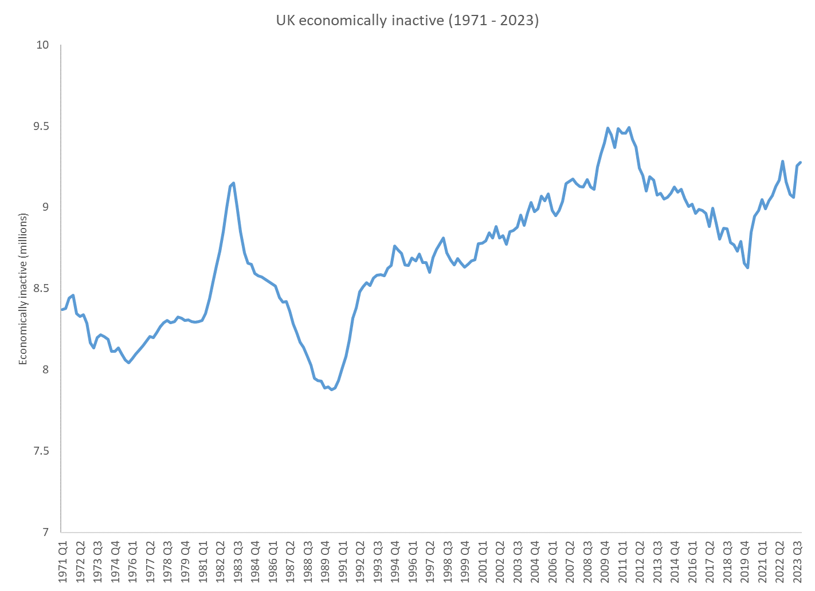
Anactif
Inactive
Ffynhonnell / Source: www.ons.gov.uk/economy/inflationandpriceindices
Notes:
The Bank of England has waited to see signs that wage growth is slowing before making a move to reduce interest rates, and is expected to view the latest unemployment and employment figures as another reason to begin that process this year. However, more recent surveys have shown UK businesses regaining confidence in the economic outlook and preparing to raise prices as employees continue to receive pay rises above the rate of headline inflation.
More than a fifth of working-age adults in the UK are deemed not to be actively looking for work, figures suggest. The UK's economic inactivity rate was 21.8% between November and January, marginally higher than a year earlier. It means 9.2 million people aged between 16 and 64 in the UK are not in work nor looking for a job. The total figure is more than 700,000 higher than before the coronavirus pandemic.
A rise in the number of people leaving the labour market, mostly due to ill-health, will also likely mean that employers struggle to find staff and wages growth falls slowly over the coming months. In all, there are well over half a million more people out of work than before the pandemic began. This is being driven by more young people and older people outside the labour force, and in particular because of more people reporting long-term health conditions that stop them from working.
This is holding back the recovery as the economy is continuing to create jobs, with nearly a million unfilled vacancies reported today.

Slide 7
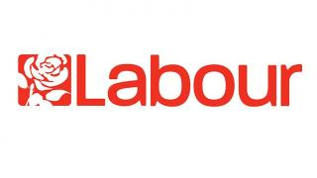



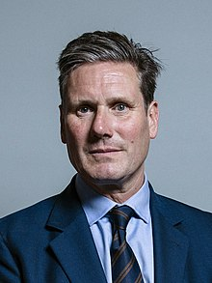
Democratiaeth
Democracy
Ffynhonnell / Source: www.wikipedia.org
Notes:
2024 will be a historic milestone for democracy. There will be more than 70 elections held this year across countries that are home to nearly 4.2bn people. 2024 marks the first instance where over half of the global population resides in countries poised to hold nationwide elections. Ballots will be cast from India to Iran, Mozambique to Madagascar. While some elections promise fresh new ideas and policies, others may reward the corrupt and incompetent and cement illiberal rulers’ position.
People across the U.K. will finally have a chance to vote for who is Prime Minister. The U.K. election must be held by January 2025 and the exact time people will get to visit the ballot box will be decided upon by the Prime Minister. After 14 years of Tory rule, most pundits believe that a Labour victory is most likely whenever the election is called.

Slide 8
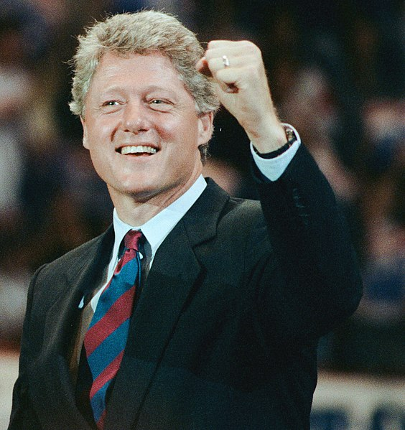
Yr economi
The economy
“It’s the economy, stupid”
Ffynhonnell / Source: www.wikipedia.org
Notes:
The Conservative and Labour parties have dominated the U.K. political arena since the 1920s. Despite its imperfections, the country’s first-past-the-post electoral system tends to ensure robust parliamentary majorities for the party in power, which helps it implement its policies. As a result, political cycles become more pronounced as parties face either rewards or repercussions based on their performance.
A key concern for most voters, here in Wales and elsewhere, is the performance of the economy. The phrase “It’s the economy, stupid” was coined by James Carville, strategist of U.S. President Bill Clinton’s successful 1992 campaign against George Bush Snr. The quip was meant to bring voters back to the fact that the campaign was being held in the middle of a recession, which the Clinton team used successfully to unseat Bush. Over thirty years on, it remains good advice to political aides. Voters in the U.K. consider the economic performance of each party as a key factor in their political decision-making, with the Conservatives enjoy a clear advantage in the British perception of which party is best at managing the economy.
Assessing a political party’s influence on the economy is not a simple task. For instance, a recently elected government requires time to draft and implement its new policies, with time also needed to show their effects. On the other hand, it could be argued that individuals and businesses adjust their behaviour before a government implements its policies.

Slide 9
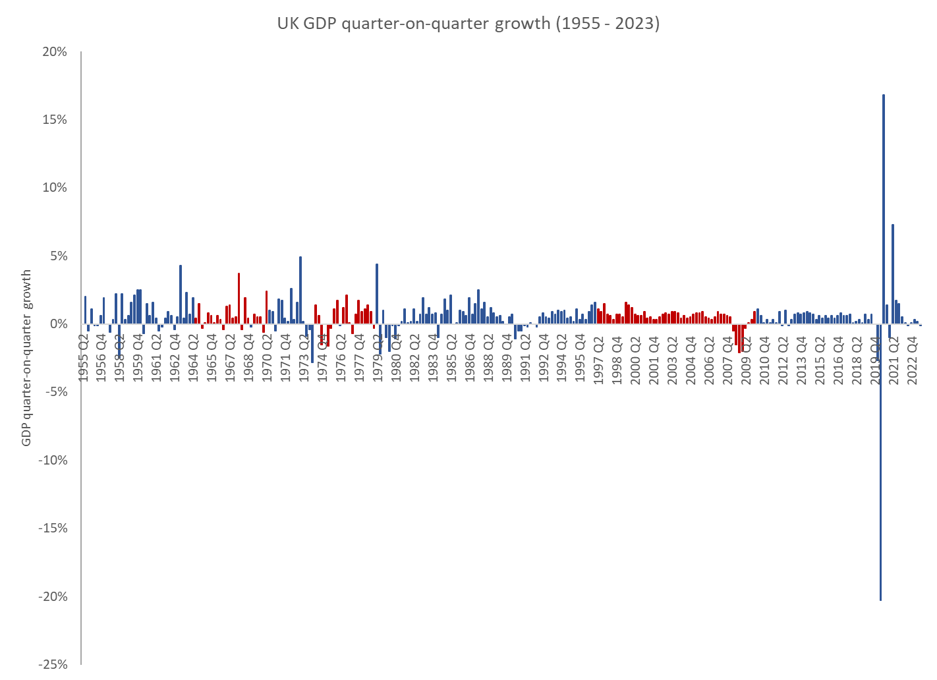
Cyflymder tebyg
Similar pace
Ffynhonnell / Source: www.ons.gov.uk/economy/grossdomesticproductgdp
Notes:
Quarterly real GDP data from the Office for National Statistics can help us see the economic impact of the two parties. Between 1955 and 2023, the Conservatives have presided over 181 quarters while Labour has been in power for 95 (for a total of 276 quarters). The British economy faced many challenges during this period; the Suez Canal crisis (1956), oil crisis and stagflation (1973), the financial crisis (2007), Brexit, Covid-19, and the cost-of-living crisis to name just a few. The average quarterly real GDP growth over this period was 0.58%; that is, the U.K. economy grew on average 0.58% in each quarter between 1955 and 2023.
Since 1955, the Conservatives achieved a slightly higher average GDP growth per quarter (0.60%) than Labour (0.55%). However, this difference is statistically insignificant. In other words, a statistical test shows that there is no real difference in how the economy performs under the different political parties. Lags of various lengths can be included in the analysis to assess whether the economic performance of either party improves as a newly elected government is given time to implement its new policies. Even when including these lags, the results do not produce a clear winner. There have been many events after 2007 that have had a negative impact on the economy – some outside the control of the U.K. government. Even when excluding these events from the analysis, there is no significant result. In short, the economy grows at a very similar pace under both the Conservatives and Labour governments.

Slide 10
Cwestiwn
Question
Who is actually in control of the economy?
Notes:
While I need to conduct further analysis to better understand the impact of the two political parties on the economy, the initial results raise an interesting question: who is actually in control of the economy? Changes in skills policy, infrastructure investment, planning reform, migration policy, and incentives around research and development can have a profound positive affect on the growth of an economy. Unfortunately for politicians, the impact of such policies will often only show up in the data a decade or so later. This is probably little comfort for those looking to be elected in 2024.

Slide 11

Diolch
Thanks
Dr Edward Thomas Jones
Bangor Business School
E-mail: e.t.jones@bangor.ac.uk. LinkedIn: in/edwardthomasjones
Notes:
Diolch yn fawr.

