Slide 1
Prof Edmund Burke
Vice-Chancellor Bangor University
Prof Pierre Guibentif
RCSL President
Prof Stefan Machura local organiser
INauguration

Slide 2

Representing Law
& the Post Office Scandal
Stefan Machura

Slide 3
Introduction
Law needs to be represented in various forms
Law is upheld by and increasingly produced by the modern state
Most law is developed outside of the state (Eugen Ehrlich)
„Post Office Scandal“ as an example how law is represented.

Slide 4
The highly valued property of trust
Generalised trust (David Easton) is key for the state, companies, every-day life to function.
It can lead to undue reliance on actors and instutitions.
Lawyers, judges, politicians etc. represent the law.
Media of various types to hold actors to account.
  They represent law, e.g. in news and TV series.

Slide 5
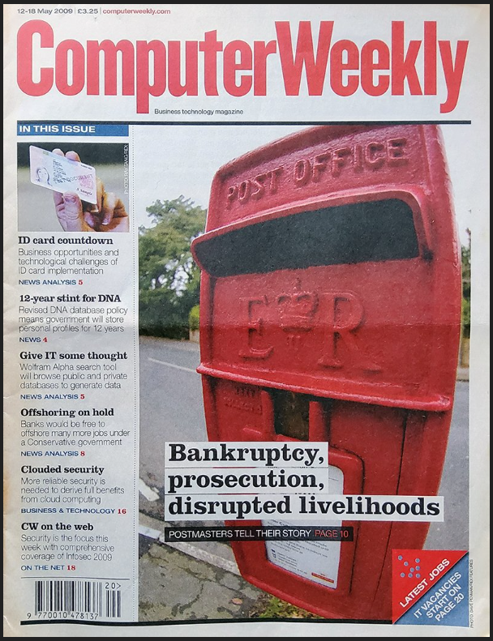
The Post Office
(WAS) one of the most trusted pillars of UK society.
Subpostmasters are typically private shopowners.
Fujitsu’s Horizon computer programme.
Lay people signed contracts they could not understand and that were possibly legally void.
Postmasters felt bound.
And ashamed as Horizon (falsely) indicated money missing.

Slide 6
Chatastrophic outcomes
“736 blameless individuals were prosecuted by the Post Office between the years 2000 and 2014 (…) More than 230 sub-postmasters and sub-postmistresses were jailed after 700 had been prosecuted for theft, fraud and false accounting and four killed themselves.”
(Nozari 2024; Augustine et al. 2024 state it continued until 2015)

Slide 7
Trials and investigations
Courts relied on Fujitsu and Post office experts
Ministers were assured that Horizon works well
Eventually, a whistle-blower revealed that Horizon was faulty
  Engineers accessed the Post Office computers clandestinely
By end 2023, it was clear that postmasters had to be compensated and cleared of allegations
But nothing much happened.

Slide 8

Trial by film
All this changed in January 2024 with a TV series representing the saga.
Public got furious.
Now government and parliament reacted feverishly.
Picture: TV series „Mr Bates vs The Post Office“ website
https://www.itv.com/watch/mr-bates-vs-the-post-office/10a0469/10a0469a0001, accessed 31/08/2024

Slide 9
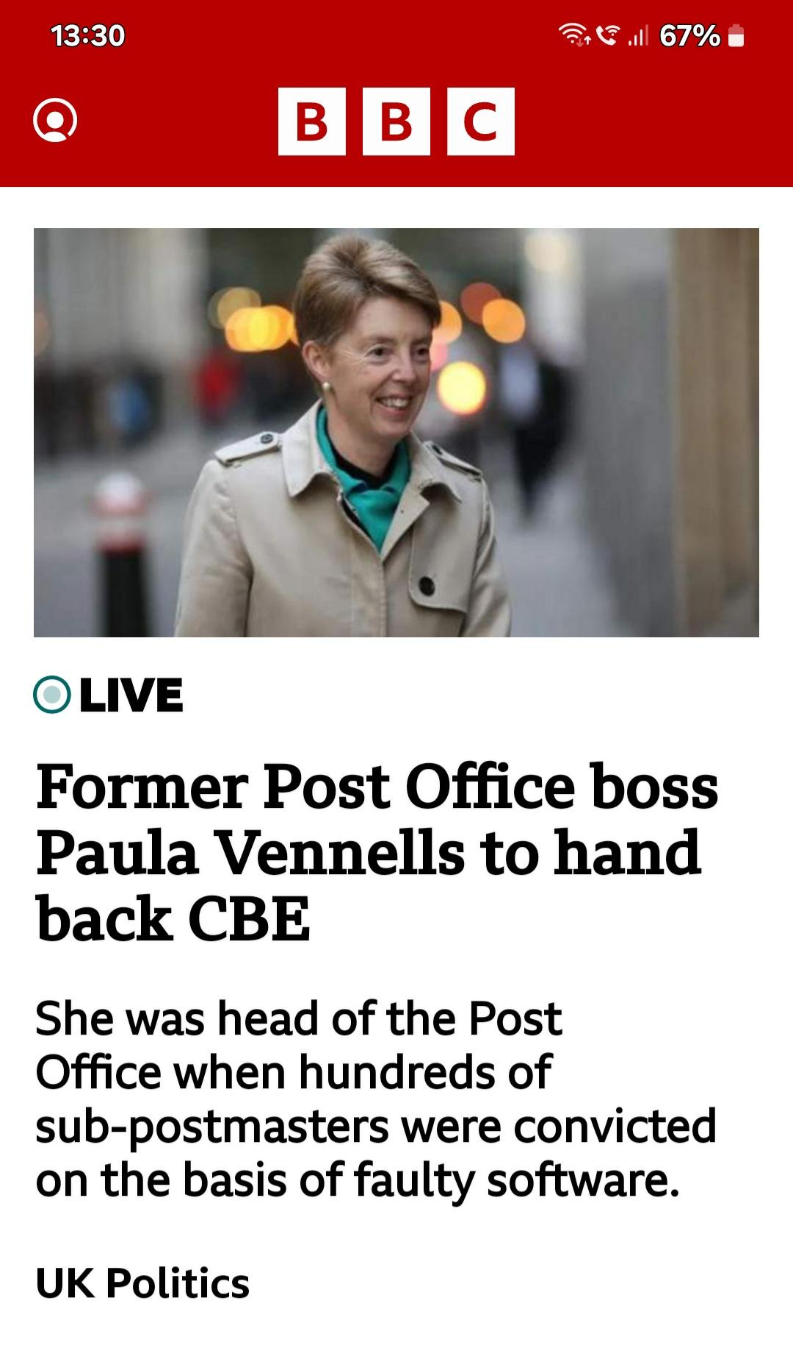
A classic drama
„Justice Figures“ vs. „Injustice Figures“ (Nicole Rafter)
Heros: Mr Bates who educated himself in IT, postmasters, their lawyers, a conservative MP, whistle blower(s), journalists
Villains: Post Office managers aiming to maintain trust and destroyed it in the process.
Source: https://unitedinfrance.com/topic/paula-vennells-the-1st-step/, accessed 31/08/2024

Slide 10
Our topics, our expertise, this conference
RCSL members
RCSL Working Groups
  Law and Popular Culture (2nd plenary)
  Law and Politics
  Comparative Legal Culture
  Human Rights
  Civil Justice and Dispute Resolution
  Knowledge and Opinion About the Law – Legal Consciousness (first plenary, now)

Slide 11
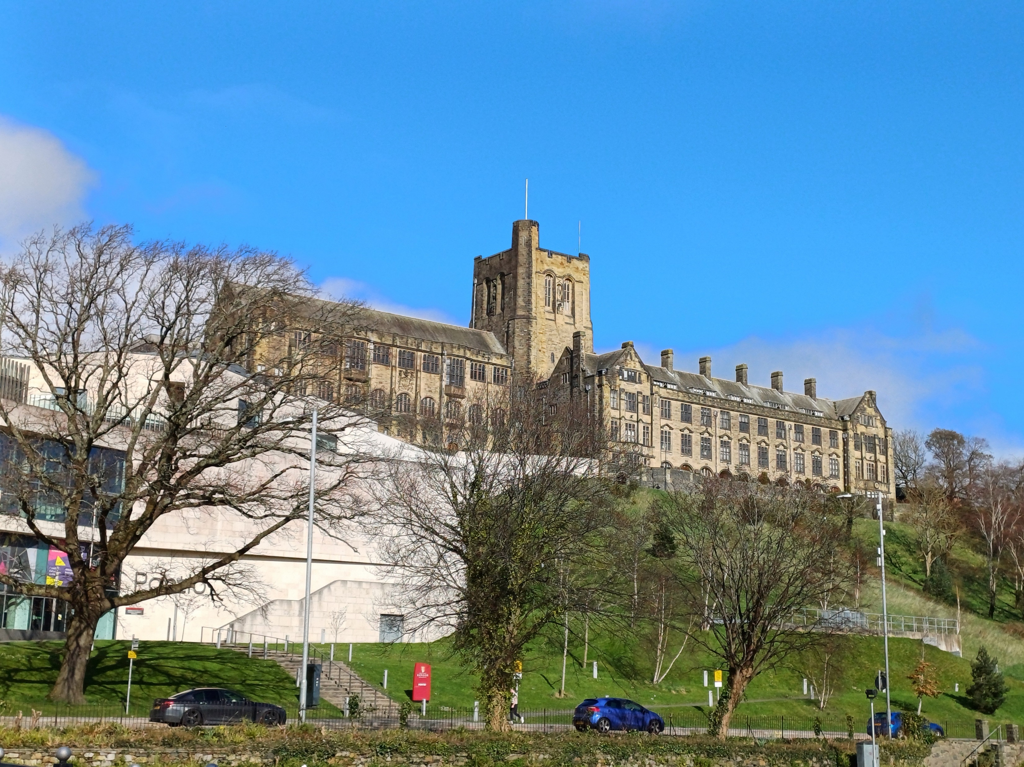
Announcements
Wi-Fi: Eduroam, The Cloud
For questions: organisation team (coloured labels, T-shirts)
Floor guide in envelope (also has tour, dinner vouchers)
Lunch breaks: in Powis Hall
Most panel sessions in LR 1, 2, 3, 5
LR 4: coffee breaks and Wednesday, Thursday book exhibition
Art and Food Evening today after 17:30 in Pontio, Level 0 (enter Pontio from Deiniol Street)

