Slide 1




Transdisciplinarity, climate change and future roles for health economists
Sofie Roberts; John Parkinson; Josephine Borghi;
Katherine Simpson; Rhiannon Tudor Edwards.
SCROLL DOWN

Slide 2

An example of transdisciplinarity
What is transdisciplinary research and policy?
'One Health' is an integrated, unifying approach to balance and optimise the health of people, animals and the environment. It is particularly important to prevent, predict, detect, and respond to global health threats such as climate change.
Transdisciplinary research as opposed to interdisciplinary or multidisciplinary research is defined as where we can create a unity of intellectual frameworks beyond our specific disciplinary frameworks.
The challenge of climate change and unequal health effects on people means we need to work together.
Notes:
Frontiers | One Health Economics: why and how economics should take on the interdisciplinary challenges of a promising public health paradigm
My only other comment relates to what you say for the ‘transdisciplinary’ slide. I don’t know your script, but I would encourage you to think of one or two examples of how TD working is *stronger* than sioled working. This may seem obvious to the converted, but if there skeptics in the audience then it will help demonstrate the value. It could be at an abstract level e.g. each discipline views ‘sustainability’ through a different lens and so by working together you get a mixed-methods convergent approach. Or about the creation of a common understanding about a problem that hitherto has divided approaches. Alternatively, the example could be more concrete: from my experience working with you and Rhiannon, you could talk about the Brasil collaboration. How HE and behavioural science focuses on the value of *behaviours* in the prevention pyramid. Or the Treborth work which has a similar theme though around motivation and satisfaction of wellbeing needs.

Slide 3
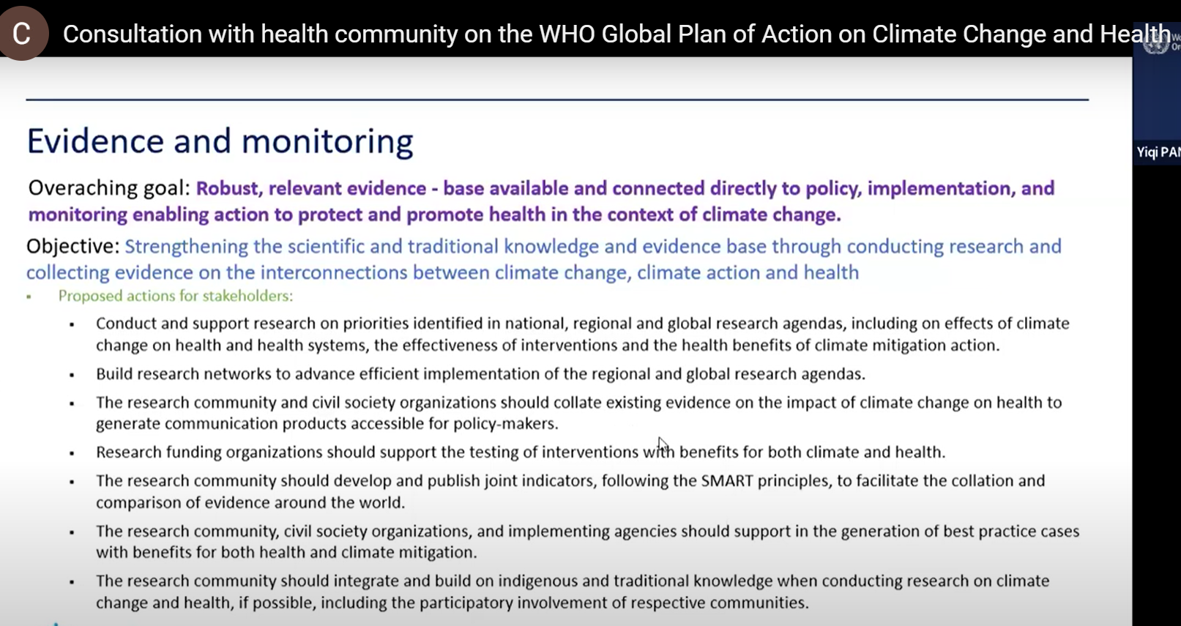
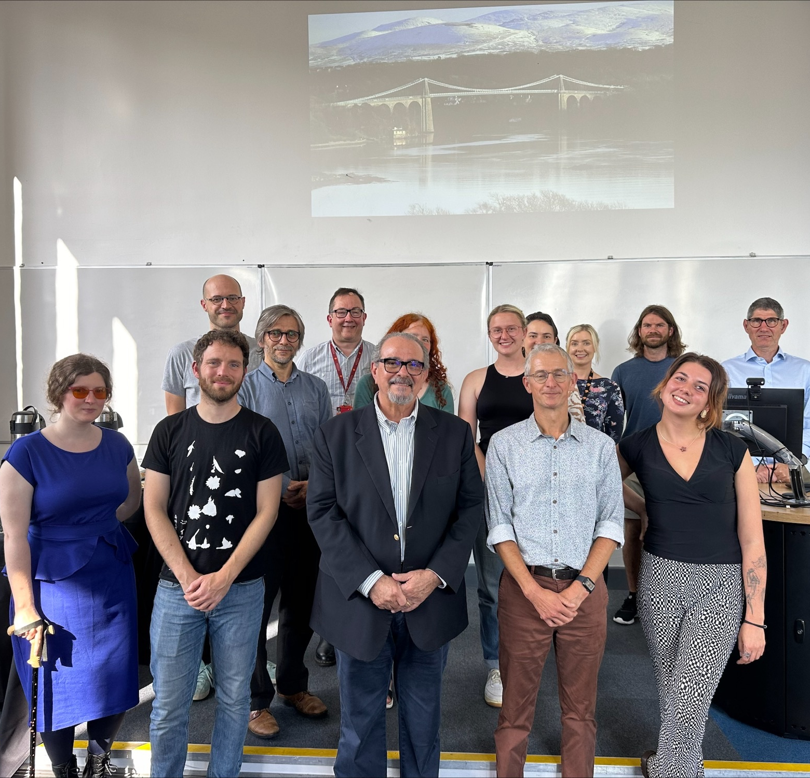
Climate change and health economics: opportunities for collaboration
WHO Consultation & EUSPR Climate Change Roundtable
  We noticed very few health economists on such calls and only few people from the UK attending and supplying evidence.
Partnership with CEUMA Universidade Brasil
  Understanding Global North and Global South views.
Policy recommendations including a health economic rationale and argument for sustainable policies and actions from Government
Adding carbon emissions to health technology assessments
Notes:
Ecological crisis

Slide 4
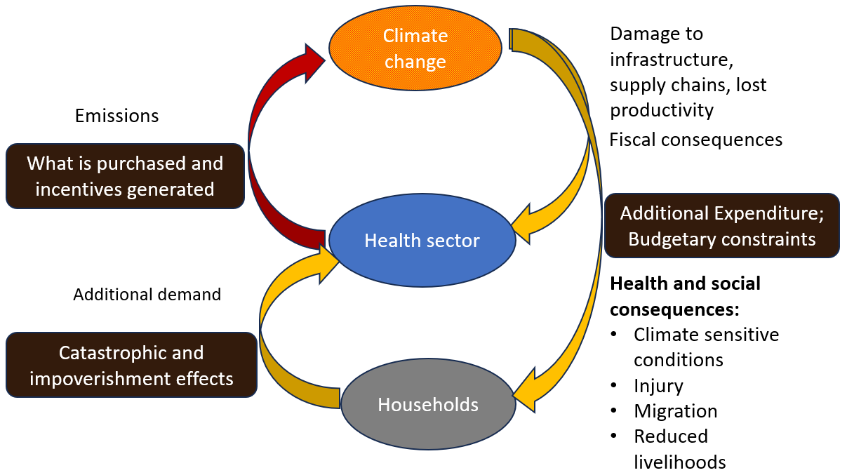
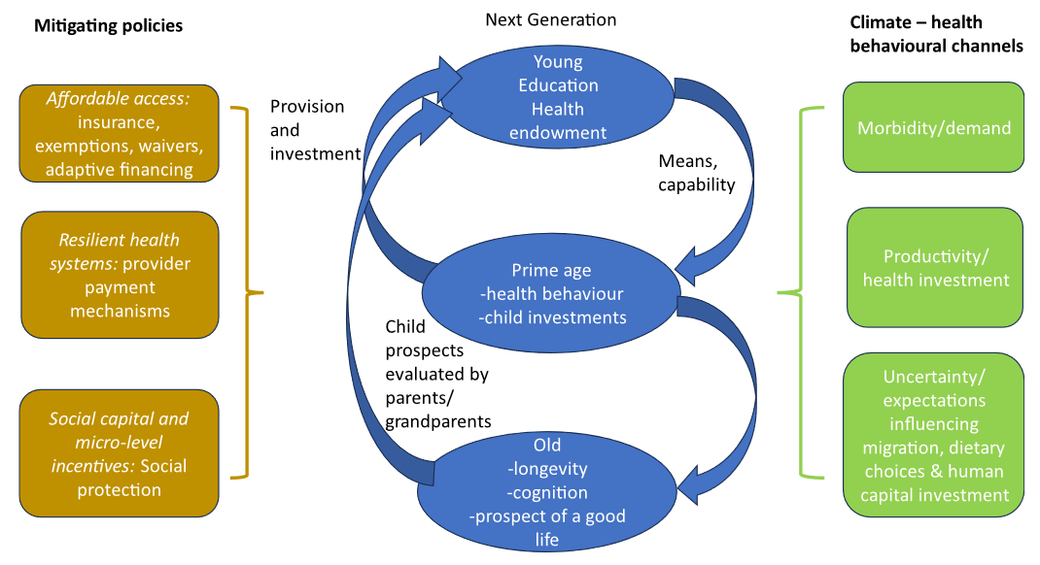
How is health economics changing as a discipline to take account of climate change?
Interconnections between climate change and health financing (Borghi, 2023)
Interconnections between behaviours, policies and health across the life-course and generations (Borghi & Kuhn, 2024)
Borghi, J. (2023, July 8-12). Is climate change relevant to health financing? [Conference presentation]. 15th IHEA World Congress on Health Economics, Cape Town, South Africa. https://healtheconomics.org/amo-event/2023-congress/ Copyright © 2023 Borghi
Borghi, J., & Kuhn, M. (2024). A health economics perspective on behavioural responses to climate change across geographic, socio-economic and demographic strata. Environmental Research Letters, 19(8), 081001.

Slide 5
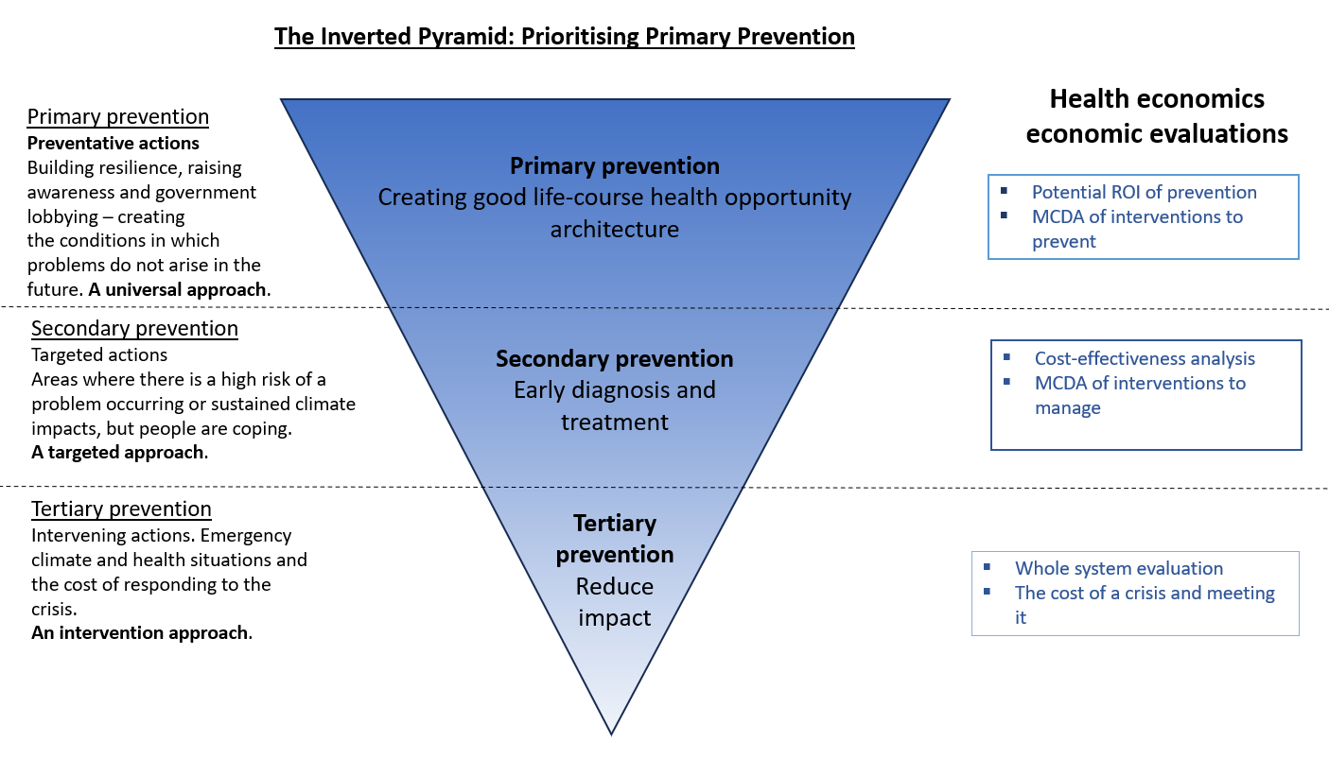
Notes:
Invite feedback on the triangle. Explain source of upside down triangle (Well-being of future generations Conference 2024).

